Slide 1
Employee Data Analysis using Excel
STUDENT NAME: Rejeena Thaslima M
REGISTER NO: 312211059, asunm1423312211059
DEPARTMENT: BCOM GENERAL
COLLEGE: DR. MGR. Janaki college of Arts and Science for Woman.

Slide 2
PROJECT TITLE
Employee Performance Analysis using Excel

Slide 3


AGENDA
Problem Statement
Project Overview
End Users
Our Solution and Proposition
Dataset Description
Modelling Approach
Results and Discussion
Conclusion
3/21/2024 Annual Review

Slide 4

PROBLEM STATEMENT
The Organization’s goal is to assess employee performance using key metrics like productivity, quality of work, attendance, and teamwork. We will use Excel to organize data, analyze trends, and create visualizations that help management identify top performers, those needing support, and department-level trends. The aim is to enable data-driven decisions to improve productivity and engagement across the organization.

Slide 5

PROJECT OVERVIEW
.
This project aims to examine employee attrition by analyzing job satisfaction levels through feedback. The goal is to identify patterns in turnover, understand the factors influencing job satisfaction. The findings will assist in developing strategies to improve job satisfaction, reduce turnover rates, and promote a more stable, motivated workforce.

Slide 6



WHO ARE THE END USERS?
Managers: To track and assess employee performance.
HR Team: For performance reviews, promotions, and development plans.
Executives: To gain insights into overall productivity trends and make strategic decisions.
Employees: For self-assessment and feedback on their performance.

Slide 7

OUR SOLUTION AND ITS VALUE PROPOSITION
Filtering - To find out the missing values
Conditional formatting - Conditional formatting helps to find out the blank values.
Pivot table - Its an interactive way to quickly summarize large amounts of data.
Chart - It is used to make a graphical representation of any set of data.

Slide 8
DATASET DESCRIPTION
EMPLOYEE DATA SET – KAGGLE
26 FEATURE
FEATURE- 9 FEATURE
EMPLOYEE ID- CATEGORICAL DATA
GENDER- MALE,FEMALE
PERFORMANCE LEVEL- ORDINAL DATA
BUSINESS UNIT- REFERENCE DATA SET
NAME- NOMINAL DATA
RATING- NUMERICAL VALUE

Slide 9

THE "WOW" IN OUR SOLUTION
New Formula Used : IFS
EG: IFS( Z8≥5,"VERY HIGH",Z8≥4,"HIGH",Z8≥3,"MEDIUM",TRUE,"LOW")
3/21/2024 Annual Review
9

Slide 10
MODELLING
DATA COLLECTION: KAGGLE WAS THE SOURCE WHICH WAS USED TO COLLECT DATA. ALMOST 26 FEATURES WAS COLLECTED AND 9 FEATURES WERE USED IN EXCEL.
SOME OF THE FEATURE WAS EMPLO YEE ID,FIRST NAME, CREDIT RATING.
DATA CLEANING: THE COLLECTED DATA WAS CLEANED AND FILTERED USING CONDITIONAL FORMATTING AND FILTER.
TECHNIQUES:
CONDITIONAL FORMATING: BY USING THIS BLANK CELLS WERE FOUND AND HIGHLIGHTED.
FILTER: BY USING THIS FILTER THE BLANK VALUES WERE REMOVED.
RESULTS: THE RESULT WAS CALCULATED ON THE BASIS OF PERFORMANCE OF THE EMPLOYEE.
PIVOT TABLE: THE PIVOT TABLE WAS DONE USING THE FOLLOWING:-
FILTER: GENDER CODE
COLUMNS:PERFORMANCE LEVEL
ROWS: BUSINESS UNIT
VALUES: COUNT OF FIRST NAMES
CHART: THE CHART CHOOSEN FOR THE ABOVE DATA IS BAR GRAPH
BY USING TREND LINE, THE LINEAR WAS SET AT VERY HIGH VALUE AND EXPONENTIAL WAS SET UP AT LOW VALUE.
10

Slide 11
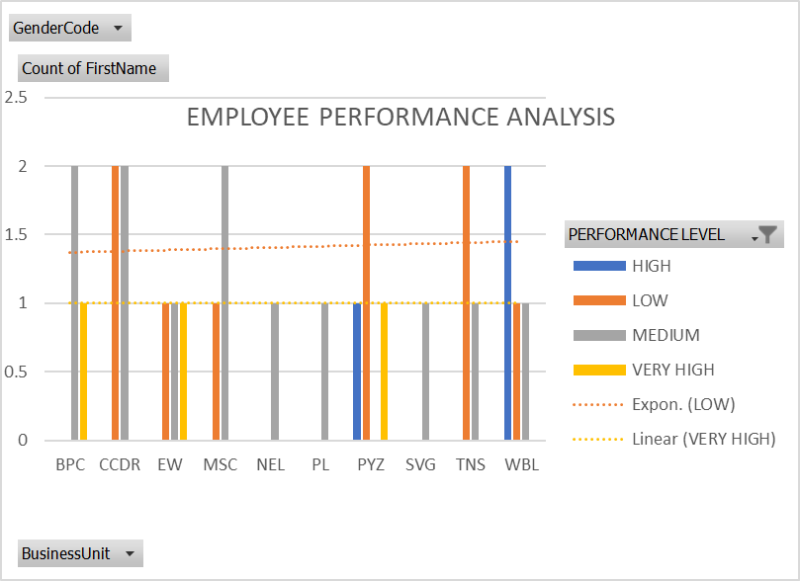

RESULTS
11

Slide 12
CONCLUSION
In conclusion, this project highlights the importance of analyzing employee turnover through job satisfaction feedback to uncover underlying factors that contribute to attrition. By identifying patterns in employee dissatisfaction, organizations can gain valuable insights into the root causes of turnover. Implementing data-driven strategies based on these insights can enhance job satisfaction, improve employee retention, and ultimately reduce turnover rates, fostering a more stable, productive, and engaged workforce that supports long-term success.

